Slide 1


Voice based DB Query Portal
Group 6:
Aayush Mandhyan
Sagar Jain
Amit Patil

Slide 2

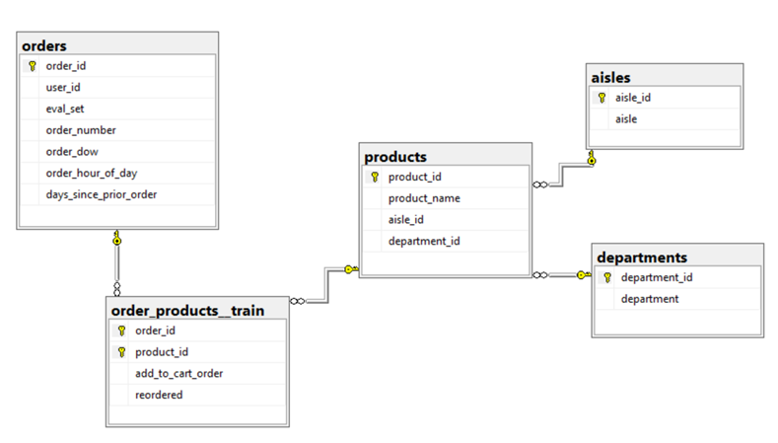
Logical Diagram [InstaCart DB]

Slide 3
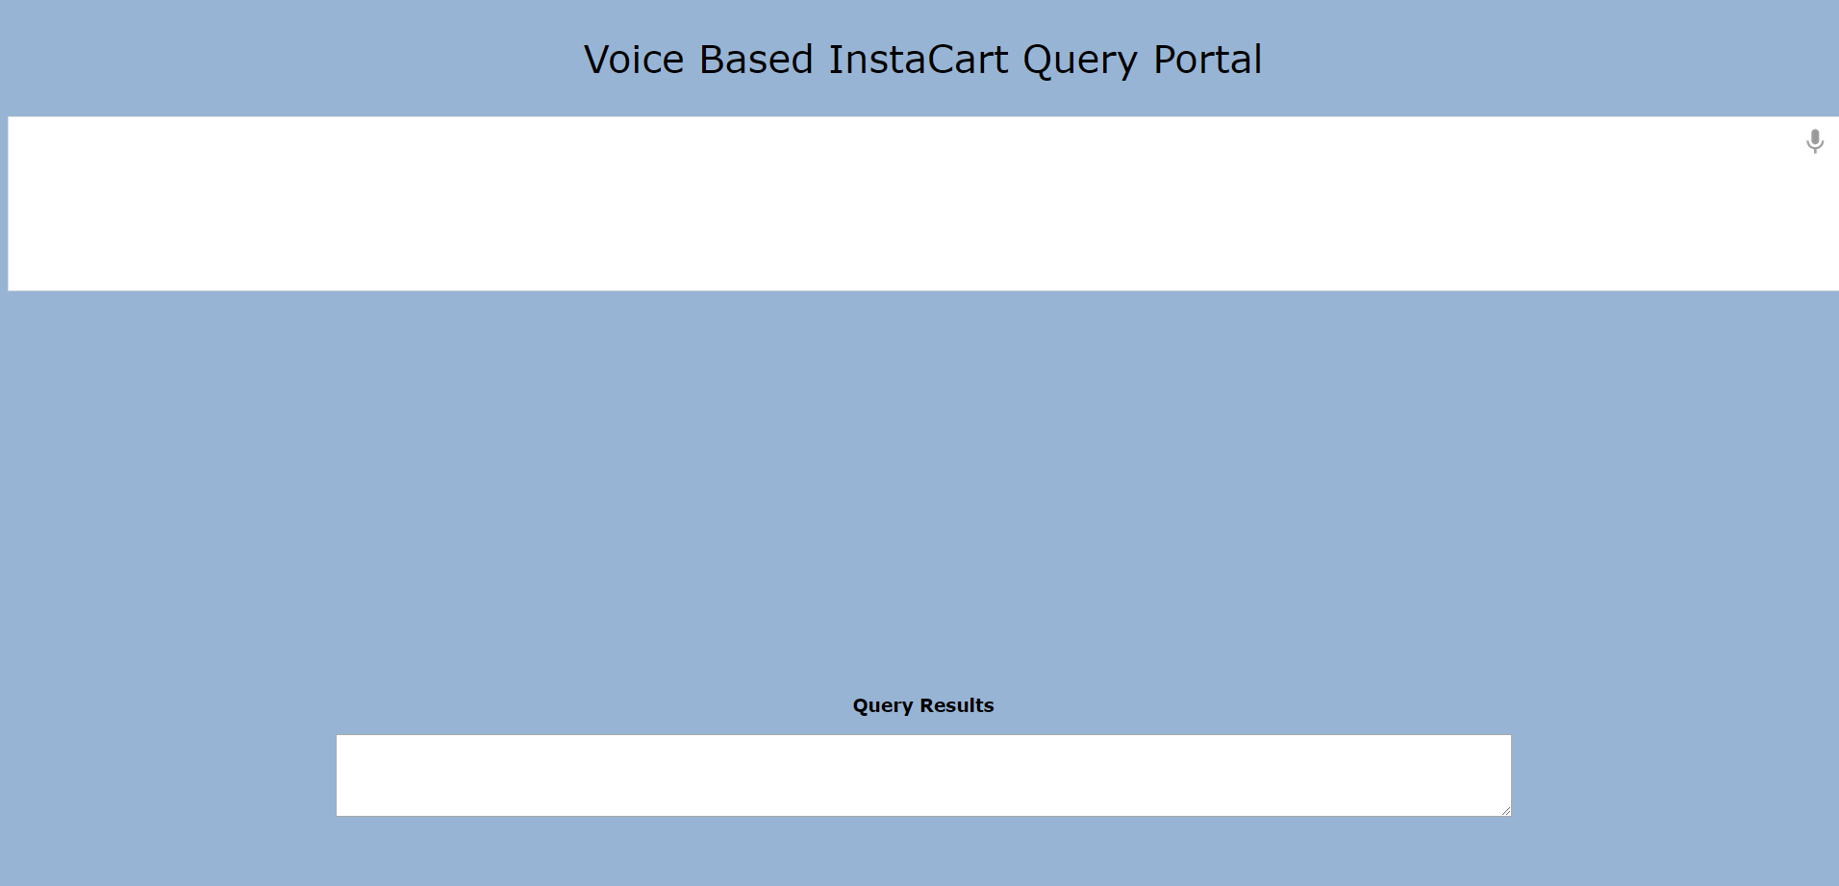
GUI

Slide 4

Technologies Used
UI stack: HTML, CSS, JavaScript
Web Framework: Python Flask
Backend: Python
DB used: Amazon RDS
Voice-To-Text: Web Speech API
(Published by Speech API Community Group)

Slide 5
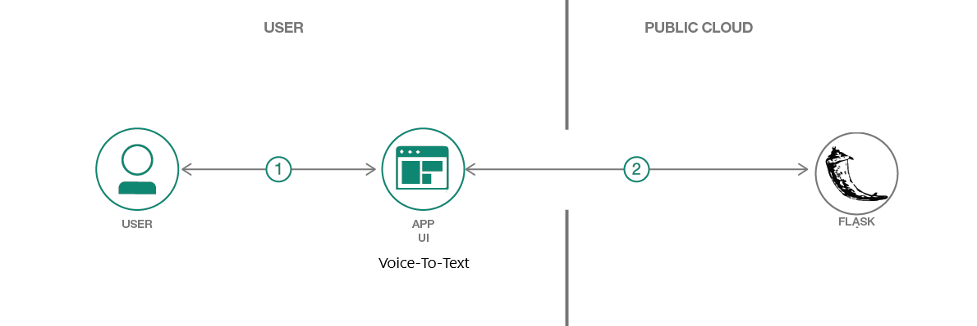
Application Flow

Slide 6
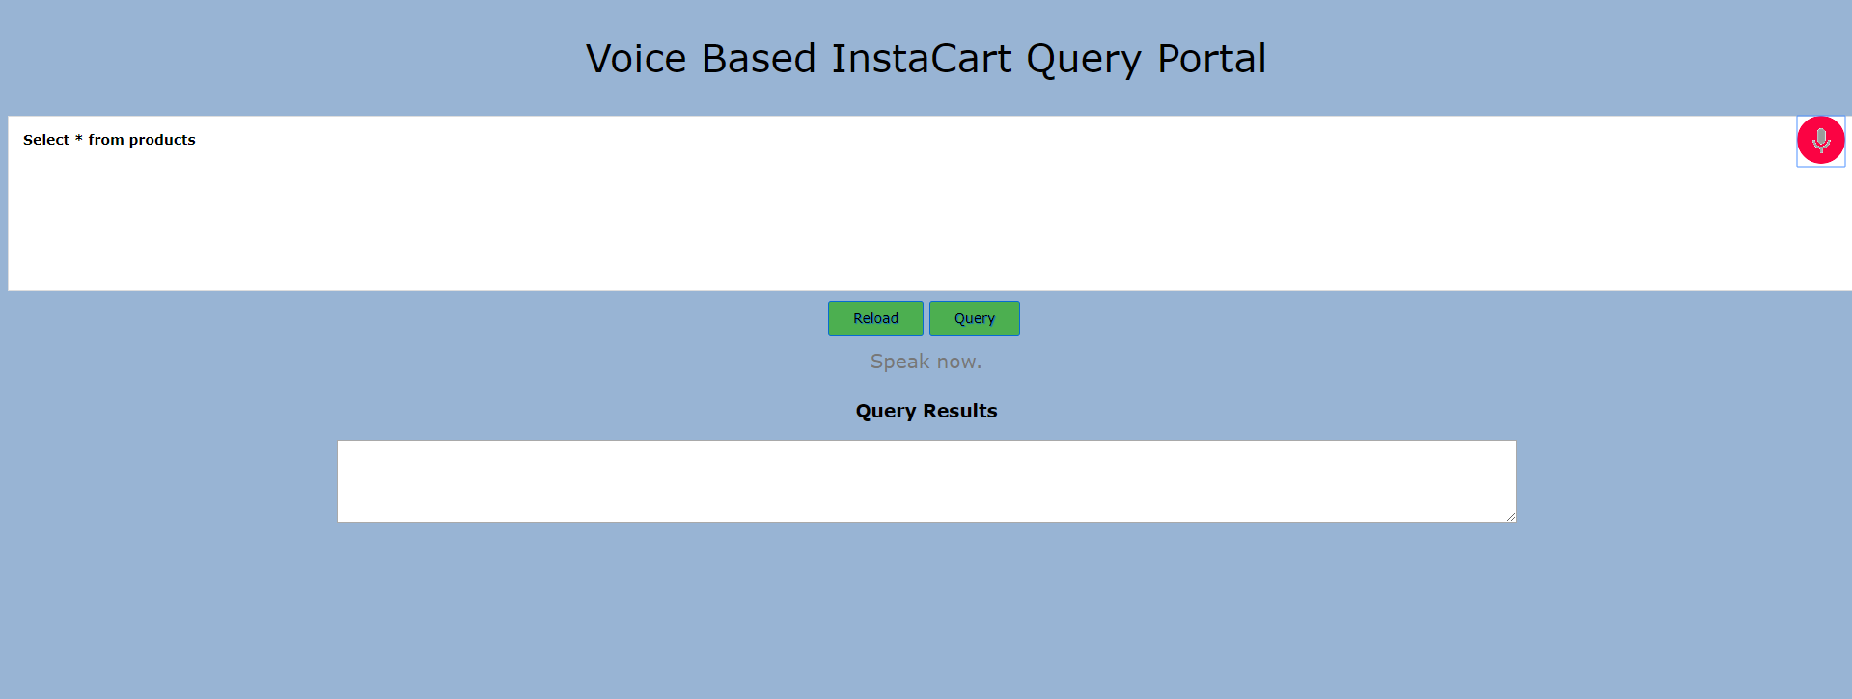
Application Snapshots

Slide 7
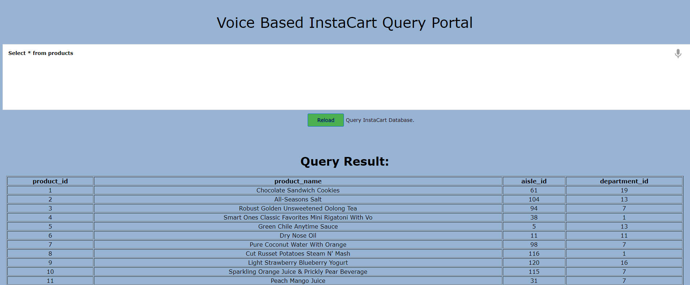
Application Snapshots

Slide 8
Thank You.

